Slide 1
Sysops Squad Redesign and Migration
The Mad Katas
May 2021

Slide 2
Not only is a solution needed, the solution needs to be enacted quickly to save this arm of the Penultimate Electronics business.

Slide 3
Problems
With the current Sysops Squad system

Slide 4
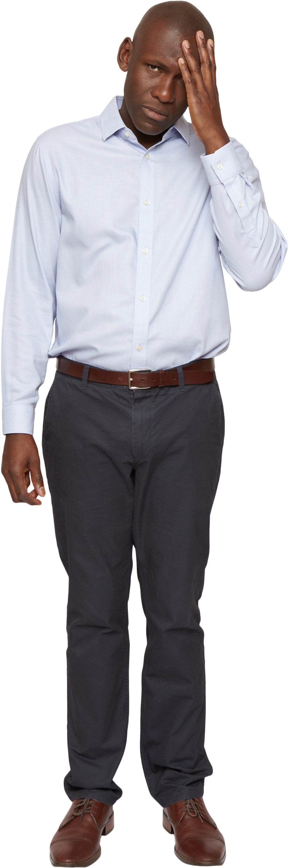
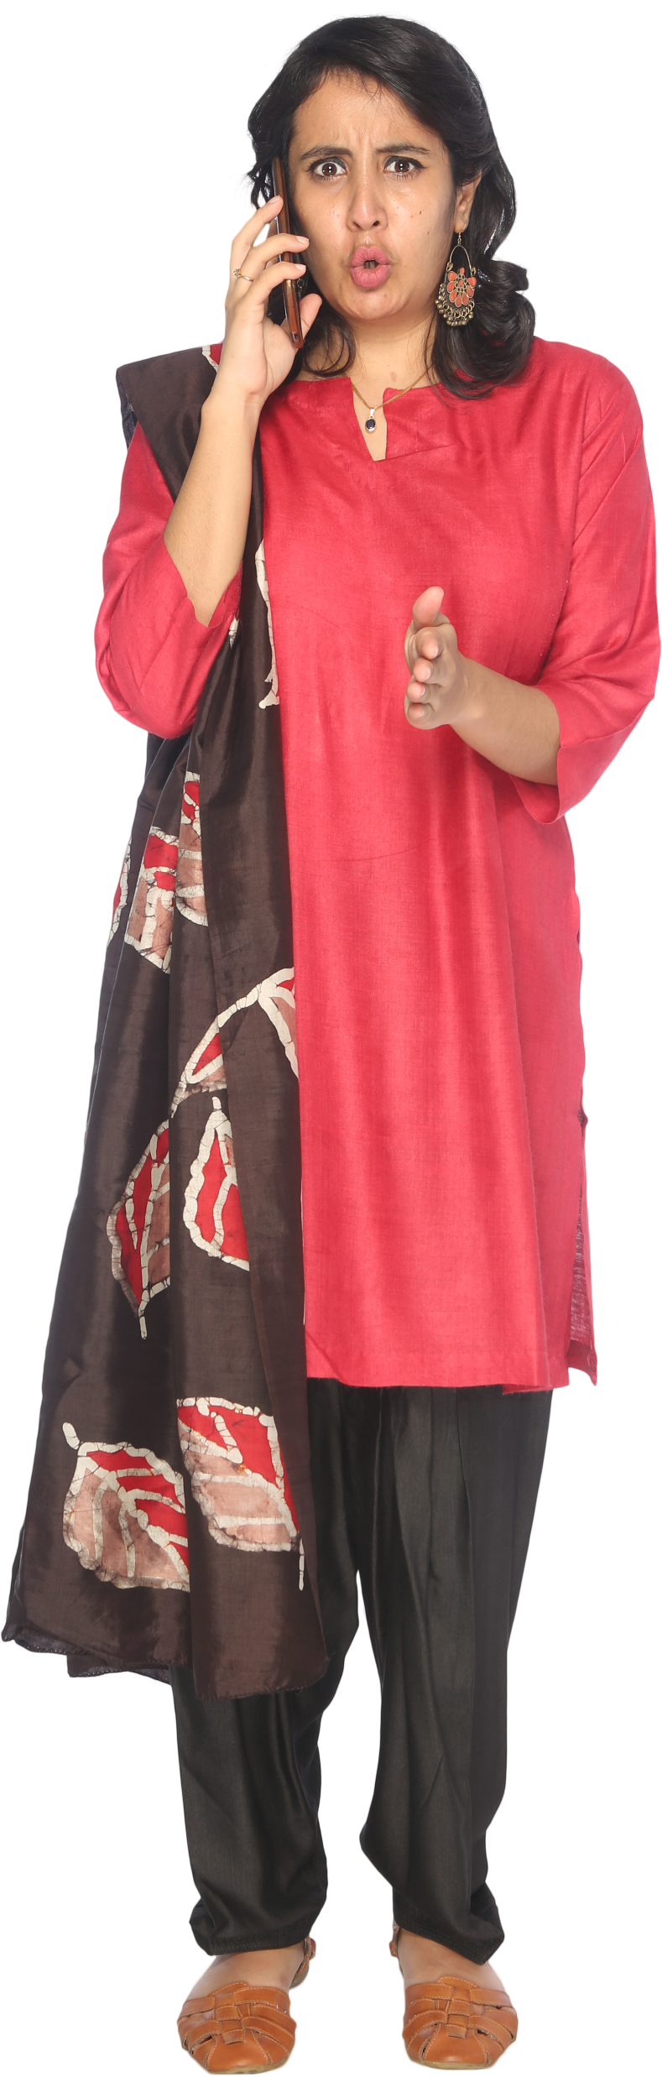
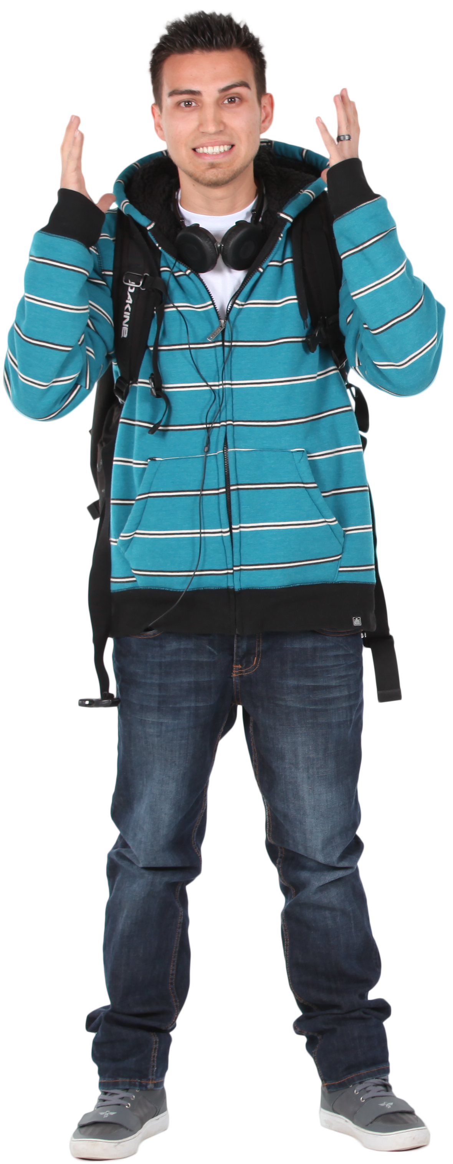
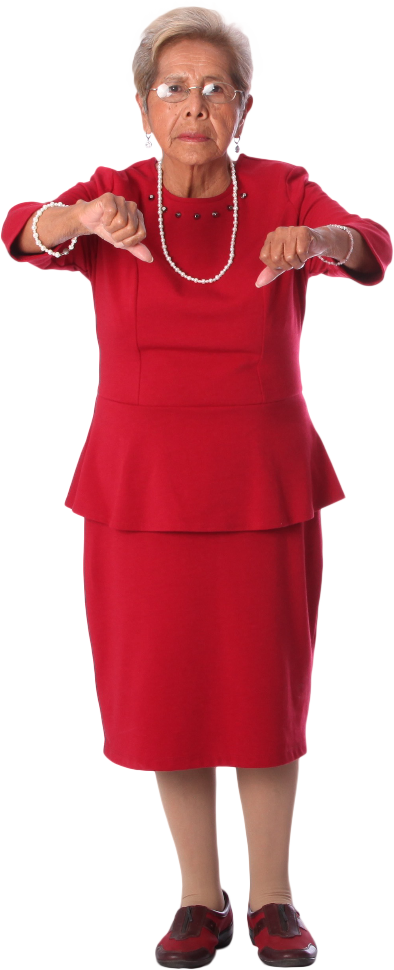
The person who showed up couldn’t fix my printer!
The person who showed up couldn’t fix my printer!
I stayed in all day and no one showed up!
I stayed in all day and no one showed up!
My laptop won’t turn on, and when I called your operator said they the ticket system was down!
I needed help with my electric hob but the website wouldn’t load!

Slide 5
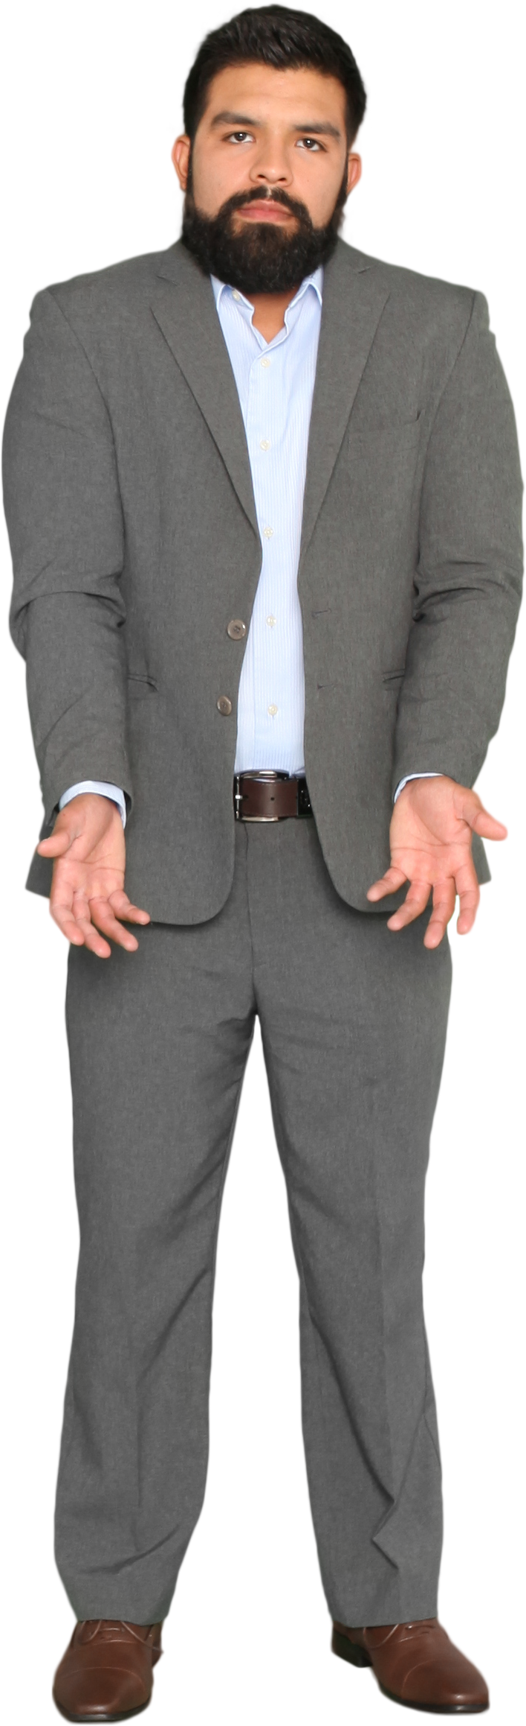

I knew I had a job to go to, but the ticket information wouldn’t load!
It was so embarrassing having to say I couldn’t fix their problem!

Slide 6

We are throwing money down the drain!
Customers will be cancelling their contracts and going elsewhere.
The brand image is being tarnished.

